Slide 1




Enabling Zuul Proxy In Spring Boot Microservices

Slide 2
What is meant by API gateway?
An API gateway is programming that sits in front of an application programming interface (API)
and acts as a single point of entry for a defined group of microservices. ...
This is because, in addition to accommodating direct requests,
gateways can be used to invoke multiple back-end services and aggregate the results.
Why do we use API gateway?
Reduces the number of requests/roundtrips. For example, the API gateway enables clients to retrieve data from multiple services with a single round-trip. ...
An API gateway is essential for mobile applications.
Simplifies the client by moving logic for calling multiple services from the client to API gateway.

Slide 3
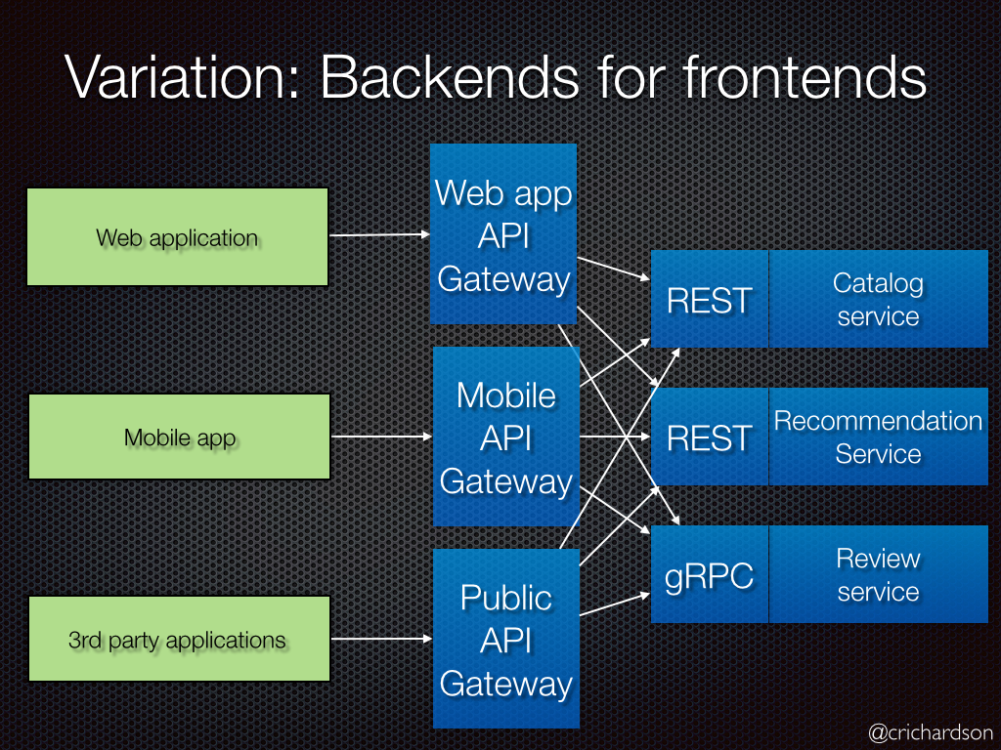

Slide 4
Do Microservices need API gateway?
An API gateway can help provide a unified entry point for external consumers,independent of the number and composition of internal microservices.
Secure Communication
It is always desirable to have SSL/TLS compliant endpoints at the API Gateway,
as well as at the microservices layer, to safeguard against man-in-middle attacks,
and bi-directional encryption of message data to protect against tampering.

Slide 5
What is ZUUL in Microservices
Zuul acts as an API gateway or Edge service.
It receives all the requests coming from the UI and then delegates the requests to internal microservices.
So, we have to create a brand new microservice which is Zuul-enabled,
and this service sits on top of all other microservices.
Types of Zull
Zuul1
Zuul2
Zuul1: Zuul serves as an Edge Service executing different tasks such as request routing, analytics,decline bad requests, authorization, and stress testing. Filters provide all these functionalities.

Slide 6
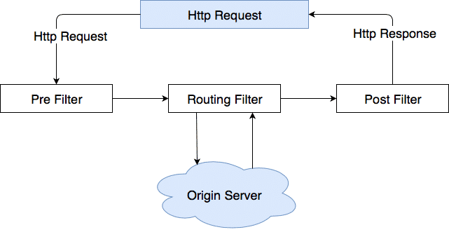
Following Figure shows the request life cycle of HTTP requests.

Slide 7
Zuul2:
The main disadvantage of Zuul 1 is that calls to the API Gateway are all blocking. If there is an HTTP request to the API Gateway, the calling thread will be blocked until the client receives a response from the server. To take care of this Netflix needed to adjust Zuul1’s architecture in order to support non-blocking asynchronous request/response lifecycles. Additionally, Netflix intended that Zuul 2 should support HTTP 2 as well as WebSockets which Zuul 1 doesn’t. As a drawback there is no backwards compatibility between Zuul 1 and Zuul 2 therefore you will have to rewrite your application if you have integrated Zuul 1 and want to transition to Zuul 2.
In order to adjust Zuul 1 for their needs Netflix has made major architectural changes to their Cloud Gateway which resulted in the newer Zuul 2. It still does the same as his predecessor Zuul 1 such as request routing, authorization and analytics but with minor changes.
One of the primary advantages of Zuul 2 is that it now provides the capability for devices and browsers to have a persistent connection to Netflix’s cloud services. This emerged due to running Zuul 2 in production for several months. Additionally, the execution of synchronous and asynchronous Filters is a huge benefit.

Slide 8
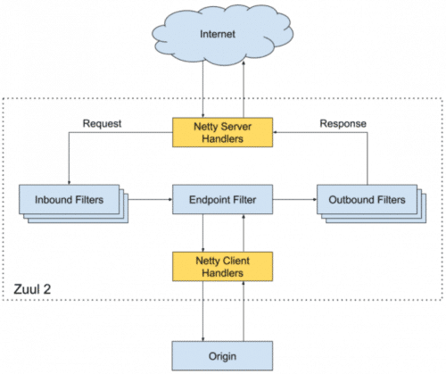
In This Figure, you see a high-level architecture diagram of Netflix Zuul 2 with Netty.

Slide 9
What Is a Zuul Proxy?
It is the common aspects like CORS, authentication, and security can be put into a centralized service, so all common aspects will be applied on each request, and if any changes occur in the future, we just have to update the business logic of this Edge Service.
Also, we can implement any routing rules or any filter implementation. Say we want to append a special tag into the request header before it reaches the internal microservices, we can do it in the Edge service.

Slide 10
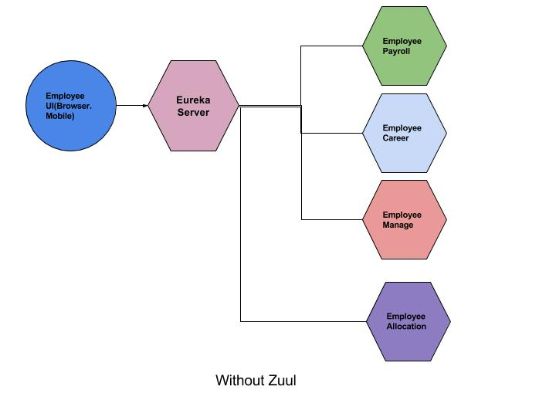
Without Zuul

Slide 11
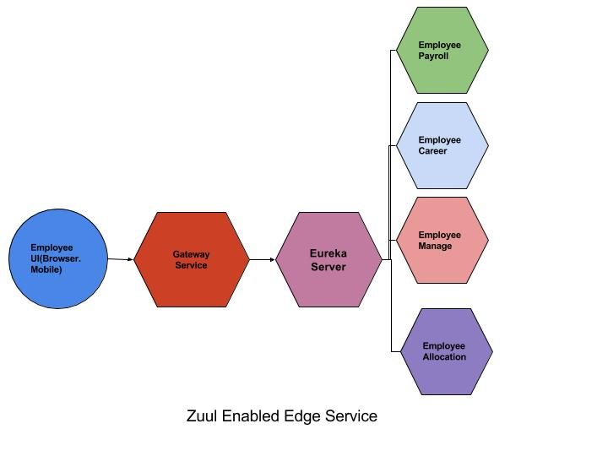
With Zuul

Slide 12
Thank You
Any Query!!!
Please Ask?

